Slide 1
CS551 Advanced Software Engineering
Tutorial 9
Node JS and Rest Services

Slide 2
Node JS Installation

Slide 3
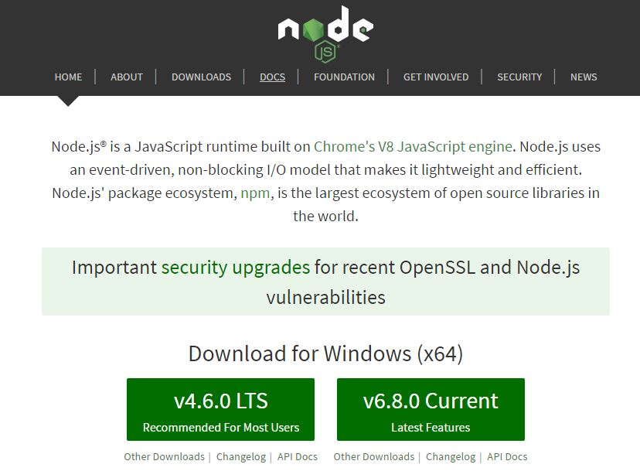
https://nodejs.org/en/

Slide 4
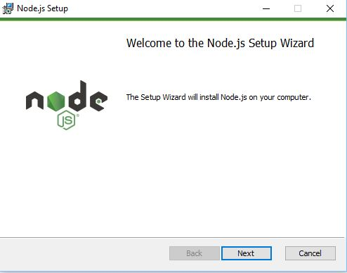
Node JS Set up

Slide 5
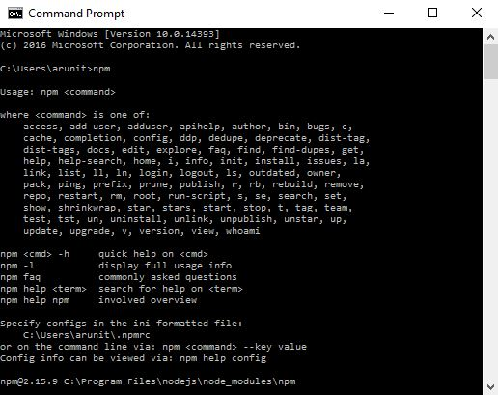
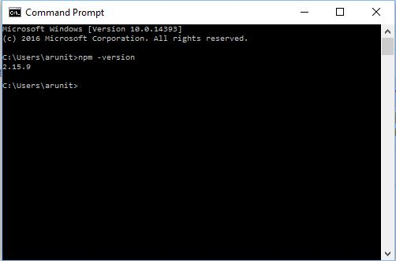
Node JS Verification
Open terminal/command prompt and type “npm” or “npm -v” to check the installation.

Slide 6
What?
Powerful Javascript-based framework/platform built on Google Chrome’s JavaScript V8 engine
Open source, cross-platform runtime environment for developing server-side and networking applications
Used to develop I/O intensive web applications like video streaming sites, single-page applications, and other web applications
Node.js = Runtime Environment + JavaScript Library
Prerequisites:
HTML, CSS, AJAX, etc.

Slide 7
Why?
Asynchronous and Event Driven
non - blocking calls & used of callbacks
Very Fast
built on Google Chrome's V8 JavaScript Engine
Single threaded
event looping
Highly Scalable
provide service to a much larger number of requests than traditional servers like Apache HTTP Server
No Buffering
output the data in chunks

Slide 8
Where?
I/O bound Applications
Data Streaming Applications
Data Intensive Real-time Applications (DIRT)
JSON APIs based Applications
Single Page Applications

Slide 9
“Say Hello” to Node
Component of a node.js application
Three Components:
Import Required Modules (to load necessary modules)
Create Server (to handle client's requests similar to Apache HTTP Server)
Read request and return response (request came from browser and response back to same browser)
How to run?
node <name_of_js_file>

Slide 10
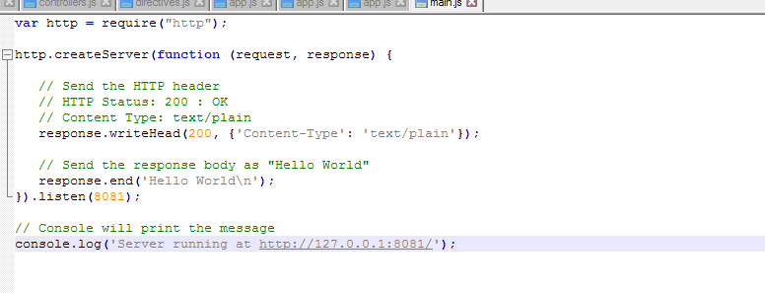
“Say Hello” to Node
Loading require module
Creating server
Handing req/res
Open terminal -> Go to your project folder -> node main.js
Go to browser -> type http://127.0.0.1:8081/

Slide 11
NPM
Online repositories for node.js packages/modules which are searchable on search.nodejs.org
Command line utility to install Node.js packages, do version management and dependency management of Node.js packages
Useful Commands:
npm –version (Check version of NPM)
sudo npm install npm –g (Install latest version of npm)
npm install <Module Name> (To install new module)
npm install <Module Name> -g (To install new module globally)

Slide 12
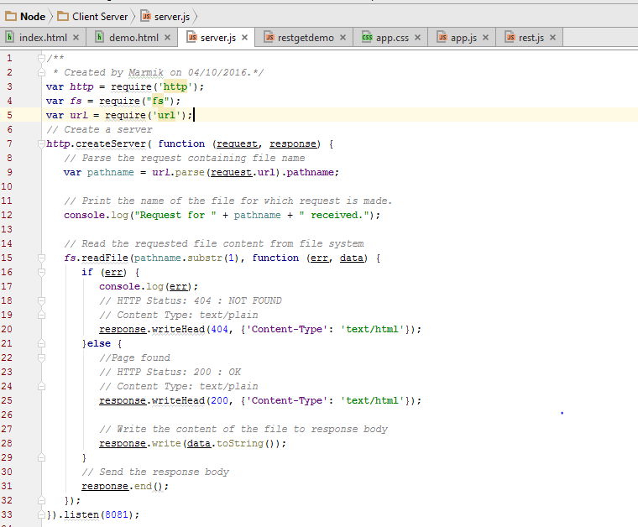
Client - Server
Creating server to handle request
Importing necessary modules
Fetching path name and responding accordingly
Creating server and listening for requests

Slide 13
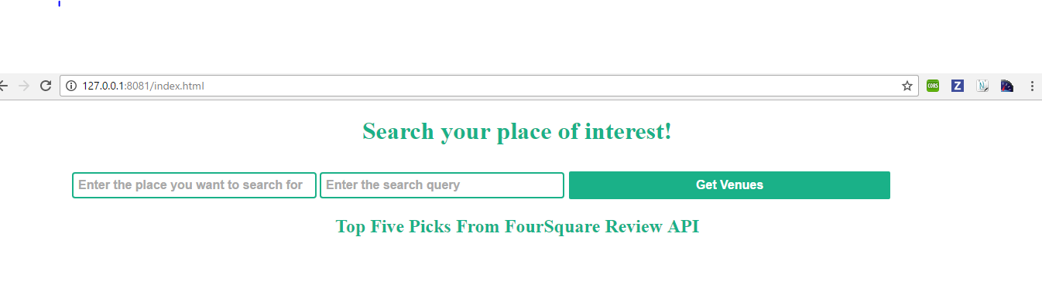
Client - Server
Accessing server from client
Open terminal -> Go to your project folder -> node main.js
Go to browser -> type http://127.0.0.1:8081/index.html

Slide 14
Rest Call
Necessary Module : request module
How to install module:
npm install request (Local)
npm install request –g (Global)
Syntax for request:
request(URL, function (error, response, body)
{
Parsing necessary details
});

Slide 15
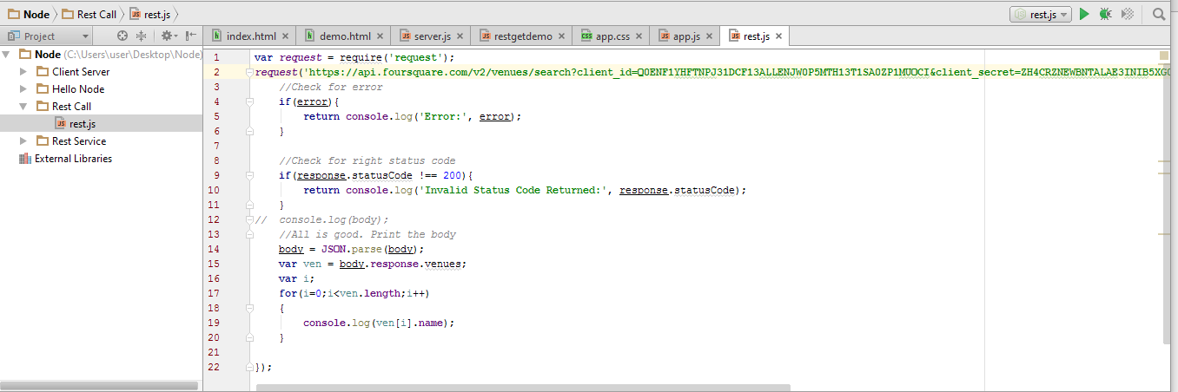
Rest Call
Calling Four Square API from node and responding back with only required details
Importing Modules
Checking Errors in Call
Checking response code
Parsing JSON

Slide 16
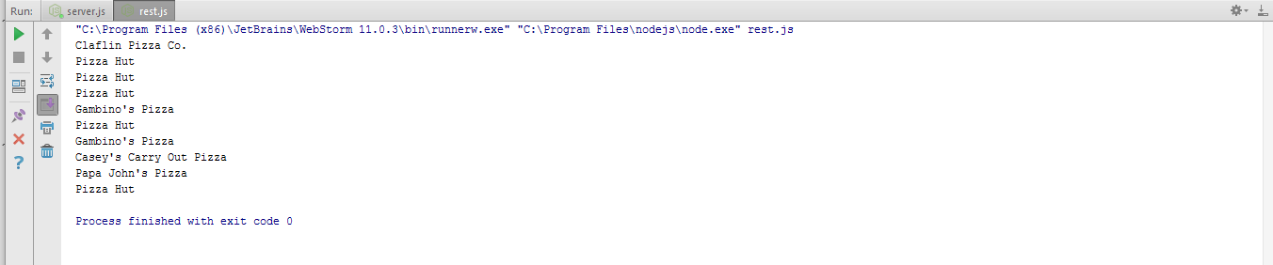
Rest Call
Calling Four Square API from node and responding back with only required details (Output)

Slide 17
Creating REST service
Use of Express Framework
minimal and flexible Node.js web application framework
provides a robust set of features to develop web and mobile applications
Features of Express:
Allows to set up middlewares to respond to HTTP Requests
Defines routing using actions and URLs
dynamically render HTML Pages based on passing arguments
Installing Express Framework
$ npm install express --save

Slide 18

Creating REST service
Creating personal REST service using Four Square
Importing necessary modules and setting up express
express – for defining method and route
request – for calling REST

Slide 19
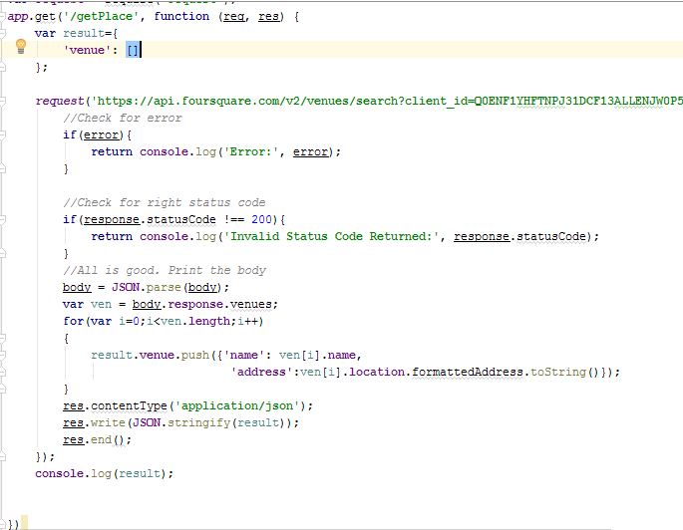
Creating REST service
Defining REST and result structure

Slide 20
Creating REST service
Calling Four Square
Checking Errors and Response Code in Call
Storing data in response structure

Slide 21
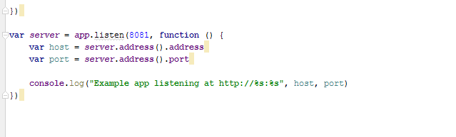
Creating REST service
Listening for Request to API endpoint (/getPlace)

Slide 22
Creating REST service
Calling REST service using endpoint
Open terminal -> Go to your project folder -> node main.js
Go to browser -> type http://127.0.0.1:8081/getPlace

Slide 23
TASK
Create a Private REST service which is Mashup of at least TWO public REST services using express framework
Use your private web service in your web/mobile/hybrid application
Submit the screenshots of the task in wiki page and post the link for it in README.md file in Github and push the code to Source folder in Github.
Submit your Lab report through: https://goo.gl/forms/YP0GW9Oq2M5GxyMG2

Slide 24
THANK YOU

